Slide 1
Jerry Xie
IT10 1012

Slide 2
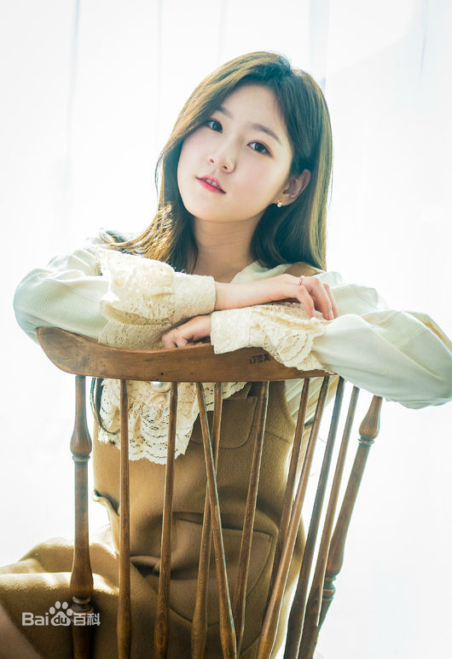
Kim Saeron

Slide 3

Interesting fact
I was very thin and strong in younger ages.

